Slide 1
The Critical Role of Youth in
Building Restorative School Cultures
Sue Perkins, M.A.Ed.
www.community-matters.org

Slide 2
Objectives
Explore and demystify the notion that school security is synonymous with school safety.
01
Deepen our understanding of how to transform the school culture from the inside out.
02
Develop 2-3 action steps for advocating and promoting restorative practices with school and community stakeholders.
03

Slide 3
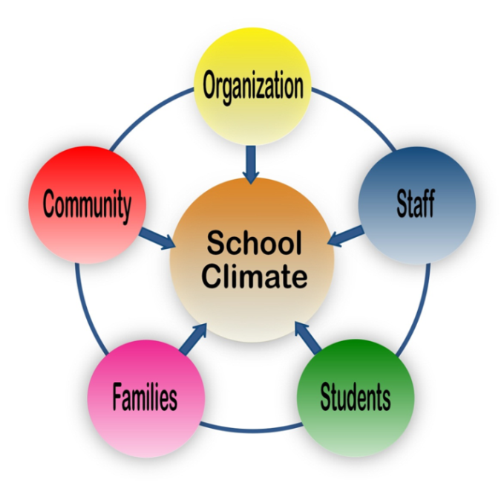
Community Matters Mission
“To equip and empower students and adults to create schools that are safe, welcoming and inclusive.”
Notes:
RP

Slide 4
Social Discipline Window
TO
(Authoritarian)
WITH
(Restorative)
Accountability
Limit Setting
Low High
Control/Expectations
NOT
(Negligent)
FOR
(Permissive)
Low High
Support
Respect
Trust
Encouragement
Love
Costello, Wachtel and Wachtel, 2009
Notes:
Link to leadership styles

Slide 5
The “Inside-Out” Approach
Relationship-Focused
Student-Centered
Formative / Restorative
Focused on Changing Social Norms

Slide 6
The Student Determinant of Whole School Climate

Slide 7
How would you engage and enroll students at your school to be Restorative Leaders?

Slide 8
Living in a Disconnected World
"We are living in an unprecedented social experiment. We have systematically changed the patterns and connections that have characterized human life as long as there has been human life."
Ted Wachtel, Dreaming of a New Reality

Slide 9
School Safety: The Changing Landscape
School Shootings
(1995 – 99)
Violence / Bullying
(2000 – 09)
(2009 – present)
Cyber-Bullying
Relational Aggression
Indifference

Slide 10
Leveraging the Power & Potential of Students
See, hear and know things adults don’t
In 88% of bullying incidents, peers are present
Can effectively intervene in ways adults can’t
First to arrive on the scene of mistreatment
Set the tone and social norms on campus
Notes:
Let’s look more closely at students...
These unique characteristics of students make them well suited to one particular key -- the one with the most direct impact on school climate... And overall safety

Slide 11
Empowering Youth: The Formula
The 3 “P’s”
(Purpose, Power and Place)
+
The 3 “E’s”
(Engage, Equip, and Empower)
=
The 3 “C’s”
(Competent, Caring and Contributing)

Slide 12
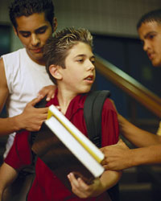
The Dynamic of Bullying & Other Mistreatment
Targets
Aggressors
Bystanders = 85%
The Passive Majority
Notes:
So what does that mean?
well it starts with understanding who the players are in the Dynamic of Mistreatment
Looking at the work of Dr. Ron Slaby professor at Harvard University and expert in the field of violence prevention
…He holds there are three players in this drama
There are the targets.. those ss getting left out, picked on bullied, teased
Then there’s the Aggressors-the ss doing the bullying, teasing, name calling
And then the bystanders – these are the ss that tend to witness mistreatment and not act
As you can see, interestingly enough they make up approx 85% of the student population which you can see
Almost 9 out of 10 ss aren’t doing the bullying or receiving the mistreatment
The challenge is how do we mobilize, activate or inspire these bystanders to speak up?

Slide 13
Increasing Student Voice
(in both formal & informal settings)
Leadership Opportunities, e.g., serving on a Climate Committee
Bystander Education & Empowerment
Peer Helping
&
Mentoring
Peer Mediating
Restorative Practices Leaders

Slide 14
Criteria for Strong Youth Development Programs
Enroll diverse student leaders
Equip students with skills
Provide staff support and guidance
Collect data and measure impact
Celebrate successes

Slide 15
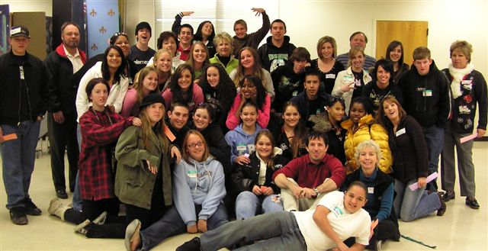
Safe School Ambassadors®
A SAMHSA NREPP Listed, evidenced-based, field-tested program that engages, equips and empowers student bystanders to reduce bullying and other forms of mistreatment.

Slide 16
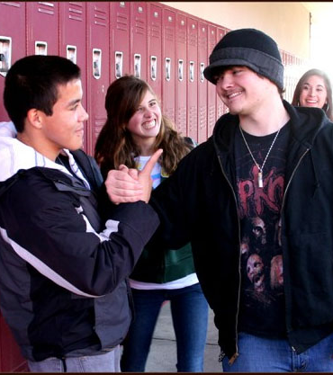
Empowering Students
Wake up Courage
Foster Empathy
Teach Skills to Gain Competence
To speak up and intervene safely and effectively.

Slide 17
People Bingo

Slide 18
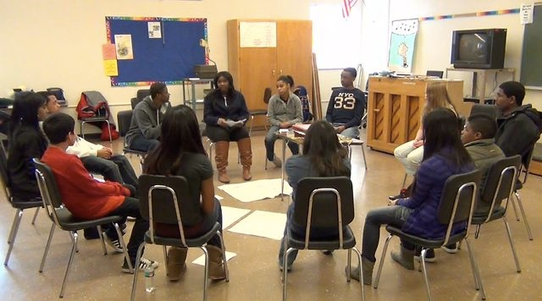
Restorative Practices –
Empowering Student Leaders

Slide 19
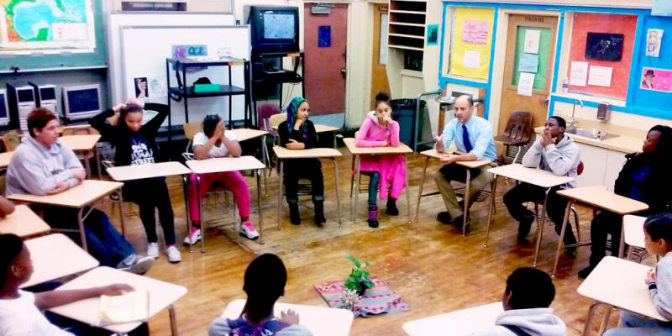
Restorative Practices Youth Training
30 Diverse Student Leaders
5 to 6 Adults
2 Full Days

Slide 20
Restorative Practices Continuum
Restorative Intervention
Restorative Questions
Affective Statements
Impromptu Dialogue
Circles
Formal Conference
Informal
Formal

Slide 21
Affective Statements
Central to all other Restorative Practices
Respectful and genuine expressions of feelings
Precise feedback on the impact of behaviors
Sometimes called I-messages
“I feel _____ when you _____ because _____.
I would like_____ .”
Helpful when accompanied by a specific request
For acknowledging positive behavior, as well as redirecting behavior

Slide 22
Restorative Questions
What happened?
What were you thinking and feeling at the time?
Who has been affected by what happened and how?
What are your thoughts and feelings about the incident now?
What has been the hardest part for you?
What do you think needs to be done to make things right?

Slide 23
Impromptu Dialogue
What happened?
What were you thinking and feeling?
Who has been affected and how?
What can be done to make things right?

Slide 24
Co-Facilitate and Lead Circles

Slide 25
Ongoing Support & Supervision
Connect & Inspire
Regularly-Scheduled
Deepen Skills
Debrief Experience
Collect Data
Notes:
EV: After the 2-day training, adult leaders meet with the trainer to establish family groups and plan for implementation.
The Family Group meetings are key because they provide the safety net to support the students who are taking on the role as an Upstander.
Family group meetings also help students connect with adults on campus, so when it comes to using the Get Help skill they learned, they have a trusted and carign adult on campus they can go to.

Slide 26
Measure Change Over Time - DATA
Use existing discipline data
Data drives decisions
Look at the numbers! Students in seats

Slide 27
Youth Empowerment Level 2
Preventing and Intervening in LGBTQ Bullying and Harassment
Peer to Peer ATOD Prevention Program
Restorative Practices
Youth Leadership Summits

Slide 28
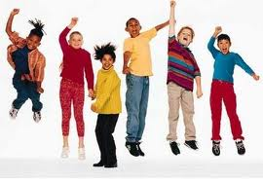
It’s easier, more effective and less costly to build strong children than to repair broken adults. Adapted from Frederick Douglass
Notes:
ALL

Slide 29
For More Information:
707-823-6159
www.community-matters.org
LeeAnn Lichnovsky,
Program & Services Director
leeann@community-matters.org

