Slide 1
Social Emotional Learning through Restorative Practices: Insights from four diverse, urban middle and high schools
Anne Gregory & Easton Gaines
Rutgers University
annnegreg@rutgers.edu

Slide 2
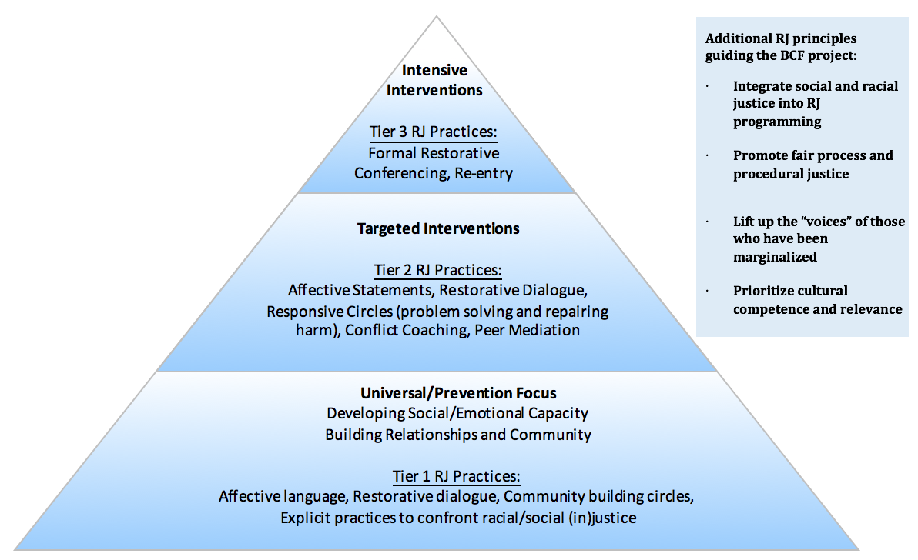
Notes:
SEL opportunities within RP
Community-circles
Morningside- Restore 360

Slide 3
Notes:
SEL opportunities within RP
Community-circles
Morningside- Restore 360

Slide 4
Rigorous statistical analyses accounted for: race, gender, income, ELL status, disability status, severity and frequency of referral.
From:. Anyon, Y., Gregory, A. Farrar, J., Jenson, J. M., McQueen, J., Downing, B., Greer, E. & Simmons, J. (2017). Implementing restorative interventions and reducing future discipline sanctions in a large urban school district. American Educational Review Journal.
Restorative Conference,
Circle, or
Mediation
Lower chance of future discipline referral
Notes:
Rigorous statistical analyses accounted for: race, gender, income, ELL status, disability status, severity and frequency of referral.
Conference students had a significantly lower odds of receiving office discipline referrals (OR = .22, p <.001) and suspensions (OR = .57, p <.001) in the second semester.
From:. Anyon, Y., Gregory, A. Farrar, J., Jenson, J. M., McQueen, J., Downing, B., Greer, E. & Simmons, J. (2017). Implementing restorative interventions and reducing future discipline sanctions in a large urban school district. American Educational Review Journal.

Slide 5
Community-building circles (proactive circles)
Lower chance of future discipline referral
Rigorous statistical analyses accounted for: race, gender, income, ELL status, disability status, severity and frequency of referral.
From:. Anyon, Y., Gregory, A. Farrar, J., Jenson, J. M., McQueen, J., Downing, B., Greer, E. & Simmons, J. (2017). Implementing restorative interventions and reducing future discipline sanctions in a large urban school district. American Educational Review Journal.
Restorative Conference,
Circle, or
Mediation
Lower chance of future discipline referral
Notes:
Rigorous statistical analyses accounted for: race, gender, income, ELL status, disability status, severity and frequency of referral.
Conference students had a significantly lower odds of receiving office discipline referrals (OR = .22, p <.001) and suspensions (OR = .57, p <.001) in the second semester.
From:. Anyon, Y., Gregory, A. Farrar, J., Jenson, J. M., McQueen, J., Downing, B., Greer, E. & Simmons, J. (2017). Implementing restorative interventions and reducing future discipline sanctions in a large urban school district. American Educational Review Journal.

Slide 6
Social and Emotional Learning (SEL)
Self-awareness: Ability to accurately recognize one’s own own emotions/thoughts and how their emotions/thoughts influence their behavior.
Social awareness: Ability for perspective taking and empathy with others of diverse cultures and backgrounds in one’s own family, school, and community.
Self-management: Ability to regulate one’s own emotions, thoughts, and behaviors effectively in different situations.
Relationship skills: Ability to establish and maintain healthy and rewarding relationships with diverse individuals and groups.
Responsible decision-making: Ability to make constructive and respectful choices about personal behavior and social interactions.
The core five social emotional learning competencies as identified by the Collaborative for Academic, Social, and Emotional Learning (CASEL, 2013). See: http://www.casel.org

Slide 7
Frequent claims that restorative practices will strengthen Social and Emotional Learning (SEL)
Restore360 helps schools honor and elevate the humanity and dignity of each child through restorative practices. The program has been introduced in hundreds of New York City public schools. Restore360 helps all members of the school community:
Strengthen their sense of connection with each other, creating a more positive school climate
Bolster their social and emotional skills and their cultural fluency
(http://www.morningsidecenter.org/node/760/)

Slide 8
What do we know about RP and SEL?
From a research perspective, not that much!
Several survey studies examined the experiences restorative conferences participants.
Findings suggest that students perceive positive social-emotional gains (Corrigon, 2012; McMorris, Beckman, Shea, Baumgartner, & Eggert, 2013). For example:
In Minneapolis Public Schools, evaluators surveyed conference participants (N = 83), a majority of whom were African American or Multiracial, from low-income backgrounds and up for expulsion due to assault or weapons related incidents.
Most students reported that the conference taught them about the impact of their behavior on people around them (75%) and how to solve problems non-violently (61%; McMorris et al., 2013).
Our study addresses a gap in knowledge: We know little about classroom-based RP and development of student SEL.

Slide 9
Current Study Design
Participants
4 middle & high schools
Northeastern U.S. city
Mostly low-income students (M = 85%)
High response rate (M = 72%)
1154 student responses
Black (43%), Latinx (18%), White (15%), Asian (9%) and Multiracial students (7%)
Notes:
the four participating middle and high schools had been implementing RP for at least a school year, all were located in a northeastern U.S. city and comprised of mostly low income students (M = 85%). On average, we had a high response rate (M = 72%), with a total of 1154 students completing the 20-minute RP school climate survey. The sample was predominantly comprised of Black (43%) and Latinx students (18%) with fewer White (15%), Asian (9%) and Multiracial students (7%). One-third reported being born outside of the U.S.
highly diverse sample and diverse in terms of immigrant status

Slide 10
Research Questions, Part 1
How do students describe the positive aspects of RJ circle and conference participation?
To what extent do students perceive circles and conferences offer opportunities for social and emotional learning (SEL)?
On our survey, students wrote in a response to the following question:
“If you participated in a conference or circle, what did you like about the process?”

Slide 11
Student Voice
Of the 1154 student respondents, 527 (46%) wrote in a response to the open-ended question:
“If you participated in a conference or circle, what did you like about the process?”
Of those 527 students, 438 students (83%) indicated specific “likes” about circles/conferences.
Notes:
Coded into different themes

Slide 12
Circles/conferences enable us to share and learn about one another
42.7%
Notes:
The most highly valued aspect of circle and conference process was the opportunity for sharing with peers and getting to know one another, as reflected in 42.7% of positive comments. Through sharing and learning about each other, we contend that students have more opportunities for perspective-taking and empathy. Such sharing, we believe gives students the opportunity to increase the SEL skill, Social Awareness.

Slide 13
Circles/conferences enable us to personally express feelings and thoughts
37%
Notes:
The next most highly valued aspect of circle and conference process was expression of their own voice, feelings, and personal opinions, as reflected in 37% of the positive comments. We contend that when students have the opportunities to self-reflect and share their own emotions and cognitions, they may increase the SEL skill, Self-Awareness.

Slide 14
Circles/conferences enable us to be heard, listen and demonstrate respect
15.3%
Notes:
A smaller percentage of comments (15.3%) touched on the positive experience of being heard through respectful, safe, and comfortable interactions. Thus, circles/conferences may offer students opportunities to practice the SEL skill, Relationship Skills. Specifically, well-structured circles/conferences may enable deep listening and respectful exchanges that foster relationship-building.

Slide 15
Circles/conferences enable us to problem-solve
4.3%
Notes:
Noteworthy was that only a small percentage of comments indicated students liked the problem-solving aspect of circles and conferences (4.3%).

Slide 16
Notes:
This suggests a need to broaden circles/conferences to engage more students in problem-solving, which is a central aspect of the SEL skill, Responsible Decision-Making.
circles aren’t really doing problem-solving so thats an area for growth.
We want to think about how these four categories of “likes” can map onto the CASEL 5.
Like I said before, sharing & learning about one another seems to fit with social awareness, personal expression with self-awareness, being heard with relationship building, and Problem solving with responsible decision making

Slide 17
Research Questions, Part 2
Is exposure to restorative practices associated with higher self-reported social-emotional competencies?

Slide 18
Current Study Design
Procedure
20-minute student survey
Number of Circles/Conferences attended
Exposure to RP, Example items:
Affective Statements: “My teacher asks students to express their feelings, ideas, and experiences”
Restorative Questions: “When someone misbehaves: my teacher asks students questions about their side of the story; my teacher has that person to talk to who they hurt and asks them to make things right; and my teacher has those who were hurt have a say in what needs to happen to make things right”
Proactive Circles: “My teacher uses circles as a time for students to share feelings, ideas, and experiences”
Fair Process: “My teacher takes the thoughts and ideas of students into account when making decisions; the administration (principal, vice principal) listens to my side of the story”
Items based on the 11 Essential Elements and Self-Assessment Survey from the International Institute of Restorative Practices (IIRP), SaferSanerSchools Program.
Notes:
A short RP Use scale was developed from IIRP’s 50-item RP self-assessment scale with multiple items for a range of RP elements (e.g., Affective Statements, Proactive Circles, Fair Process). The specific items were purposely selected to reflect four of the 11 Essential Elements of RP that are used by teachers in classrooms

Slide 19
Current Study Design
Procedure
California Healthy Kids Survey–Social Emotional Health Module- Short
Empathy: “I feel bad when someone gets their feelings hurt; I try to understand what other people go through; I try to understand how other people feel and think”
Self-Efficacy: “I can work out my problems; I can do most things if I try; There are many things that I do well”
Emotional Regulation: “I accept responsibility for my actions; When I make a mistake I admit it; I can deal with being told no”
Behavioral Self-Control: “I can wait for what I want; I don’t bother others when they are busy; I think before I act”
Self-Awareness: “There is a purpose to my life; I understand my moods and feelings; I understand why I do what I do”
Persistence: “When I do not understand something, I ask the teacher again and again until I understand; I try to answer all the questions asked in class; When I try to solve a math problem, I will not stop until I find a final solution”
Notes:
The California Healthy Kids Survey (CHKS) Social Emotional Health Module (SEHM) was developed by researchers at UC Santa Barbara. Given the time constraints for data collection, a short module includes 7 elements of Soc Emot Health
The elements represented are...

Slide 20
Correlations
Students who reported their teachers more frequently used RP, also reported higher:
Empathy (r = .37, p > .01)*
Self-Efficacy (r = .32, p > .01)*
Emotional Regulation (r = .37, p > .01)*
Behavioral Self Control (r = .36, p > .01)*
Self-Awareness (r = .29, p > .01)*
(N = 787-1109)
* these associations held when accounting for race, gender identity, sexual identity.
Alphas of subscales range from .71-.86

Slide 21
Correlations
Students who reported participating in more community building circles, also reported higher:
Empathy (r = .09, p > .05)*
Emotional Regulation (r = .09, p > .01)*
Behavioral Self Control (r = .09, p > .01)*
Self-Awareness (r = .07, p > .05)*
(N = 787-1109)
Range of circles: 0-50
* these associations held when accounting for race, gender identity, sexual identity.
Alphas of subscales range from .71-.86

Slide 22
Why might RP and SEL scales be significantly related?
RP use, # of circles: and
Empathy
Self-Efficacy
Emotional Regulation
Behavioral Self Control
Self-Awareness

Slide 23
RP Use # of Circles
Empathy

Slide 24
RP Use # of Circles
Empathy

Slide 25
RP Use # of Circles
Self-Awareness

Slide 26
RP Use # of Circles
Emotional Regulation

Slide 27
RP Use # of Circles
Behavioral Self Control

Slide 28
Limitations
All based on student self-report
Rater bias
Literacy Effects and sample selection bias
Notes:
Significant correlations may reflect Rater bias? Or more positive students may rate higher on all scales
Self report SEL doesnt show increased skills, just self-reporting that theyre more competent
Social-Emotional scale was at the end of a rather lengthy survey. Stronger readers may have been more able to finish the survey than their less reading savvy peers
Might it be the vase that those less literate student may benefit even more
If Lower completion rate kids who are less literate we dont know if these associations hold

Slide 29
Next steps and future directions
Next year, we will implement a USDOE-funded randomized control trial in 19 Brooklyn schools.
We will examine increases in adult SEL as well as student SEL
Need for research examine whether RP helps develop trusting, culturally responsive relationships with students of diverse racial and ethnic backgrounds.

Slide 30
It takes a village to conduct a comprehensive evaluation!
A big thanks is due to my Rutgers team!
Aria Hurley, Crystal Molyneaux, Neela Karikehalli, Russi Soffer, Philip Oliveira, Easton Gaines, Amanda Santiago

