Slide 1
Check & Connect
Mentor Training

Slide 2
Check & Connect
Check & Connect is a comprehensive intervention designed to enhance student engagement at school and with learning for marginalized, disengaged students in grades K-12, through relationship building, problem solving and capacity building, and persistence. A goal of Check & Connect is to foster school completion with academic and social competence.
http://checkandconnect.umn.edu/
Notes:
Carrie

Slide 3
Theoretical Perspectives that Inform Check & Connect
Resilience
A caring adult supporting a student who faces adversity fosters resilience. The adult focuses on reducing risks and enhancing protective factors.
Systems Theory
There must be connections among schools, families, and the community for supporting disengaged youth and promoting school completion.
Cognitive- Behavioral Theory
Check & Connect uses cognitive-behavioral problem solving to enhance competence, design interventions, and foster student autonomy and personal responsibility.
Intrinsic Motivation
Students find purpose and meaning in education when their psychological needs for autonomy, belonging, and competence are met.

Slide 4
C&C Mentor
Builds Relationships
An effective mentoring approach that focuses explicitly on the student's educational performance
Helps Student Participate
Be knowledgeable about student's interests, strengths, and needs. Suggest activities that are feasible and relevant.
Helps Student Navigate School / Track Progress
Weekly monitoring of student data is key. Provide ongoing feedback and communicate regularly with families and teachers.
Personalizes Interventions and Targets Strategies
Tailor interventions to meet student needs. Monitor progress and dialogue with student and others.
Works Collaboratively with Families and School Staff
Create a social support system for the student.
Makes Referrals for Students and Families
Get to know the student and family, providing school and community resources as needed.
Helps Student Set Educational Goals
Discuss and support goal setting, both immediate and future-oriented. Discuss aspirations.
Helps Student Problem Solve
Build skills to assist with problem solving. C&C uses a 5-step problem solving plan.
Helps Student Persist in the Face of Challenges
To persist, students/families need a sense of optimism and hopefulness. Persistence, Continuity, and Consistency.
Shares Information About Systems Issues
The mentor is vigilant about school policies and practices that the student and parent believe are working against them and address.

Slide 5
Desirable Mentor Characteristics
A personal belief
that all students have abilities, strengths, can learn, can make progress, and can change their level of engagement at school and with learning;
in the power and value of problem solving with students to develop personal competencies.
A willingness to
be a mentor (vs. feeling obligated);
persist despite student behavior/decision making;
cooperate and collaborate with families/school staff.

Slide 6
Skill 1: Relationship-Building
The Check & Connect mentor
Recognizes that quality relationships develop naturally over time
Takes time to get to know the student
Reaches out, even when student appears uninterested or indifferent
Uses both formal and informal connections
Builds on strengths.

Slide 7
Initial Mentoring Sessions with Student
Explain program to student. E.g., “Check & Connect supports students to have a good school year and to work on personal goals. We will meet each week and discuss attendance, academic progress, and other topics. For areas of concern, we will problem solve, and I will help you get the resources you need to be more successful at school. I will work with you for the entire school year. What questions do you have about this program?”
Have student complete Youth Outcomes Survey.
Program Introduction
Learn about student’s interests and goals.
“Relationship-Building Conversation Starters” and The “Strengths-Based Student Interview” are helpful resources. Questions can be asked over time vs. one sitting.
Schedule weekly sessions and be consistent.
Build Rapport
Contact teachers and request weekly progress reports.
Update monthly data monitoring sheet regularly. Every Friday afternoon or Monday morning is recommended.
Monitor Progress

Slide 8
Skill 2: Check
Systematically monitor student’s level of engagement and educational progress
Use monthly data monitoring form: check grades, attendance, progress, get teacher feedback regularly

Slide 9
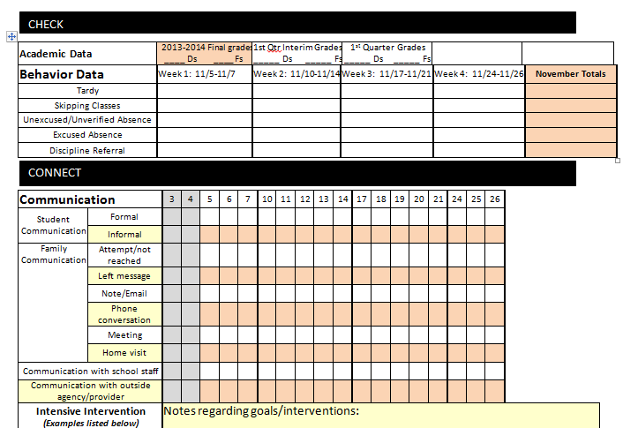
Component 2: Regular Checks Monthly Data Monitoring Form

Slide 10
Check & Connect Theory of Student Engagement
Defined as the student’s
Active participation in academic and co-curricular/school-related activities
Commitment to educational goals and learning
Subtype | Indicators | Facilitated By
Academic | Grades, time on task, credits | Utilizing after school programs, increased home support for learning, etc.
Behavioral | Attendance, office referrals, classroom participation | Developing personalized approach to attendance issues, addressing skills such as problem solving and anger management, etc.
Cognitive | Perceived relevance of schoolwork, goal setting | Using problem solving skills, setting realistic goals, creating an interest in learning
Affective | Identification with school, belonging, perceive connection with teachers/peers | Increasing support from parents/teachers, building relationships, assisting with personal problems

Slide 11
Skill 3: Connect
Connect with student in a timely manner to provide personalized, data-driven interventions
When determining interventions, consider data, student’s needs and perspective, family influences and circumstances, available school/community resources
How often do you connect? At least weekly
How long do you connect?
Basic Intervention – may be only 15 minutes
Intensive Intervention – may be 30+ minutes
When will you connect with students? Consider student and teacher preference, avoid core instructional time

Slide 12
Core Strategies of “Connect” Interventions
Problem Solving – Basis for teaching students productive coping skills. Important characteristics of problem solving include strengths-based communication, enhancing decision-making skills, and fostering self-determination
Goal Setting – Mentors help students set goals for the immediate situation in school and for the future.

Slide 13
Component 4: Family Engagement
Mentors function as liaisons between home and school – striving to build the constructive family-school relationships for C&C students.
Guidelines for mentors include:
Maintain a positive, honest orientation to communication with parents
Develop a two-way communication system
Focus all communication on the student’s school engagement/progress
Ensure that parents have the information they need to support their children’s education
Recognize that trusting relationships develop over time

Slide 14
C&C Intervention Parent Meeting
Share Student Data
Share and review data used to identify student for program
Receive parent feedback on factors contributing to struggles
Education for Parent on Attendance
Share attendance law/policies/processes
Share info/statistics on the impact of school attendance (Attendance Works Handout)
Share Information on C&C Program
Provide permission slip and review components
Answer questions and receive parent permission

Slide 15
Sample Introductory Statements
Sample Introduction and Explanation of Program for Parents:
“Check & Connect is an intervention that will help your child have a good school year, stay connected to school, and be more successful in school. It encourages students to use problem solving strategies, complete schoolwork, and participate in school activities.”
Sample explanation of the Mentor’s Role for Parents:
“As the Check & Connect Mentor, I will meet individually with your child once a week at school. In these meetings, we will discuss their attendance, academic progress, and behavior. For areas of concern, I will problem solve with him/her or help him/her access other services at school or in the community. I will also contact you to share information about their progress. I will work with him/her regularly for the entire school year.

Slide 16
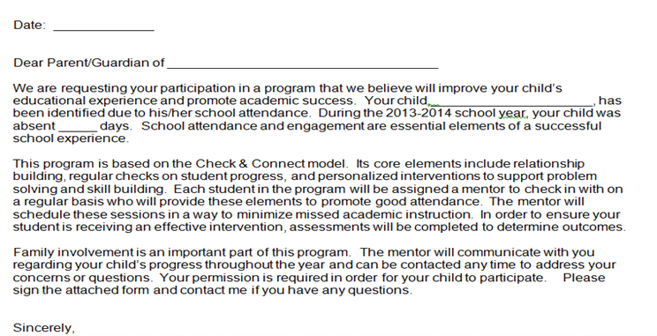
C&C Parent Permission Form

Slide 17
The Mentoring Experience
4 Core Components
Mentoring
Monitoring
Timely Intervention
Family Engagement
https://youtu.be/5B5okZHzJx4

Slide 18
Basic Intervention
A deliberate, structured conversation that typically includes:
*Sharing data
*Providing the student with feedback
*Discussing the importance of staying in school
*Problem solving about risk indicators
These conversations typically occur once a week
Help students internalize important messages about school and change their behaviors to meet school expectations (ie. attending regularly, working hard in class, completing assignments, improving grades, etc.)

Slide 19
Basic Intervention: Problem Solving
Mentors guide the student through the problem solving process, but are not directive:
1. Stop. Think about the problem.
2. What are some choices?
3. Choose one.
4. Do it.
5. How did it work?
Mentors build students’ capacity to solve their own problems.

Slide 20
FAQs
I’ve tried to connect with my mentee the past 2 weeks and they are absent. What should I do?
When you try to connect with your mentee and they are absent, attempt to reach the student by phone or email immediately. Follow up with the parent if you are unable to reach the student.
Consult with the C&C coordinators if you are having difficulty connecting with your student regularly.
Scheduling to meet your mentee and expecting them to show may not be effective in the early months. Reminders, providing a pass, or actually going to get them may be necessary until the relationship and routine are established.

Slide 21
FAQs continued:
How often should I be contacting the parent?
Contact with parent/family should occur at least monthly, depending on the needs of the student.
The monthly contact can simply be an update on the student’s progress/achievements, or there may be more frequent contact to problem-solve ongoing challenges.
It is important that 2-way communication is established early on and that the parent/family knows how to contact the mentor if needed.

Slide 22
Mentors Connect Students
Mentors are not expected to meet students’ needs on their own
Mentors are able to identify needs and connect students to appropriate resources in the school or community. Examples include:
*Tutoring
*Extracurricular Activities
*Mental Health Support
*Physical Health Resources
School social workers can support mentors in providing community resources to mentees and their families

Slide 23
Confidentiality
As a mentor, you may learn private/personal information about your mentee and family. It is important to keep such information private and not discuss it with others without permission.
There are circumstances when you will need to share information. Please contact your C&C coordinators when
1. Your mentee is in danger of hurting himself/herself.
2. Your mentee is in danger of being hurt by someone else.
3. Your mentee is in danger of hurting someone else.

Slide 24
Mentor Resources
Check & Connect Mentor Role
Youth Outcomes Survey
Personal Education Plan / Goal Setting
Intervention Examples
Guidelines for Engaging Parents
Monthly Data Monitoring Forms
Check & Connect Google Folder

