Slide 1
Participatory Budgeting
When both numbers and people count
Linda Kligman
Vice President for Administration

Slide 2
“Attention is the currency of leadership”
(Heifetz,1994, p. 113)

Slide 3
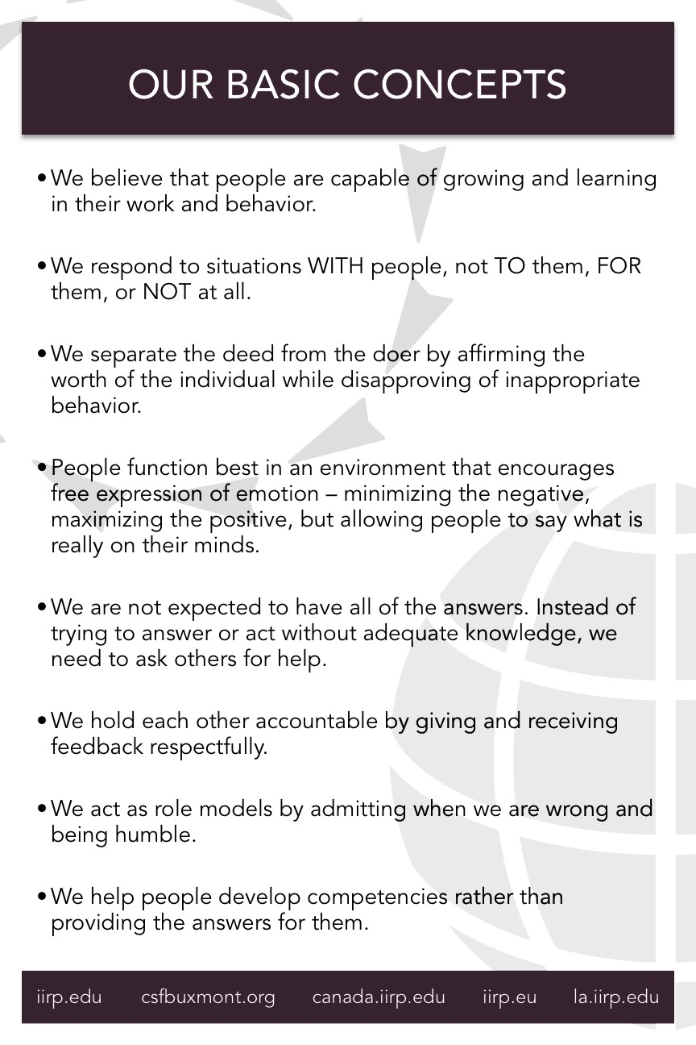
Participatory Learning
AN Everyone culture
“Business growth requires people who are developing;
developing people requires the rich context for growth that a business provides.
Both are true at once. Neither is true without the other.”
(Kegan &Lahey, Miller, 2017, p. 189).

Slide 4
Participatory Decision Making
Fair process
“Rely on the input from those on the front lines,
because that’s where intelligence about the environment is highest, fastest, and most accurate.”
Engagement
Explanation
Expectation Clarity
(Giles, 2018, p. 109)
(Kim & Maugborgne, 1997)

Slide 5
Buying new software
Infrastructure Decisions

Slide 6
Decision Making
Staff & Directors

Slide 7
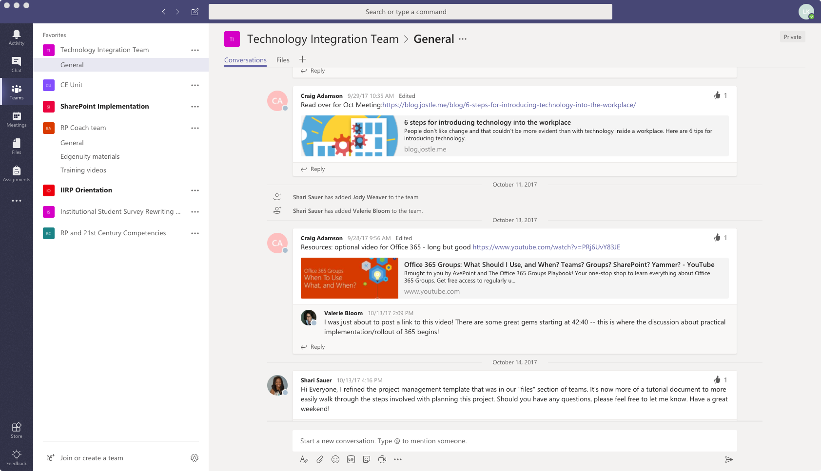
Group Learning: online team space
Collect institutional knowledge
Share future plans
Learn from mistakes
Transparency

Slide 8
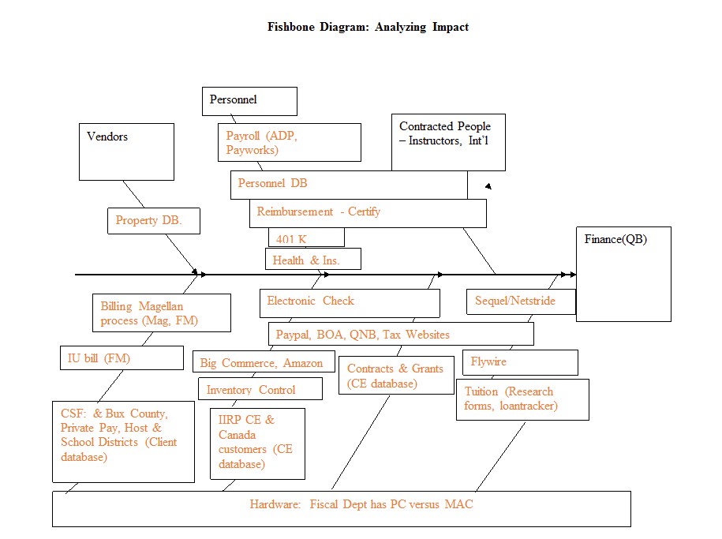
Engagement: Professional learning Groups

Slide 9
Engagement>Explanation>Expectation Clarity
Projects
Professional Learning Groups
Proposal
Project Management

Slide 10
Health Benefits
Investing in Staff

Slide 11
Decision Making
Human Resources & Financial Director
IIRP’s Cabinet

Slide 12
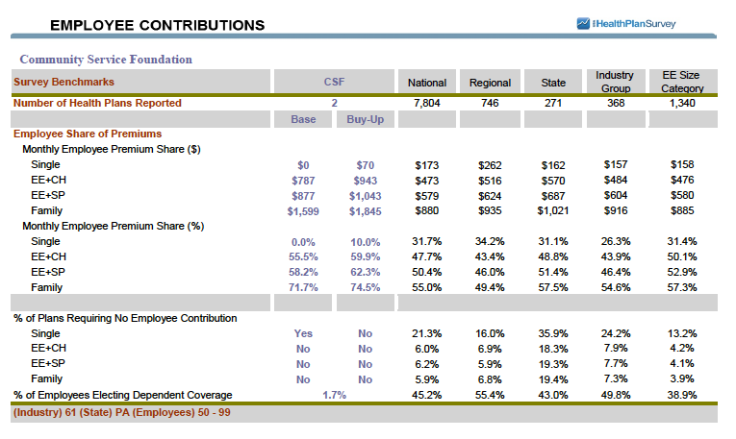
Group Learning: Benchmarks
Competitive environment
Industry Trends
Incremental Targeted Growth

Slide 13
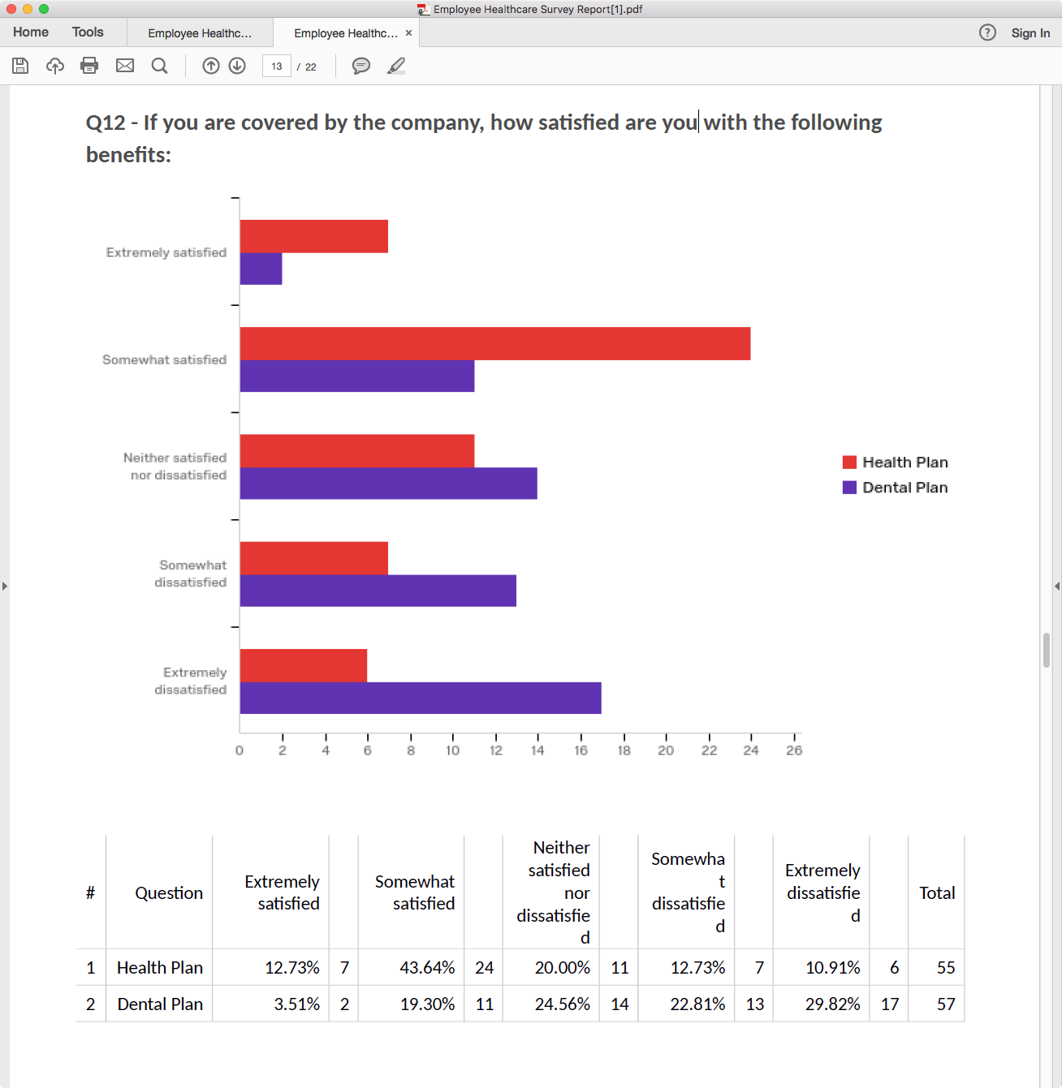
Engagement: Employee surveys

Slide 14
Engagement>Explanation>Expectation Clarity
Benefits
Surveys
All Staff Meetings
Email Communication

Slide 15
Annual Budgeting
Institutional Allocations

Slide 16
Decision Making
Unit Leaders
Committee of the Whole
Board of Directors

Slide 17
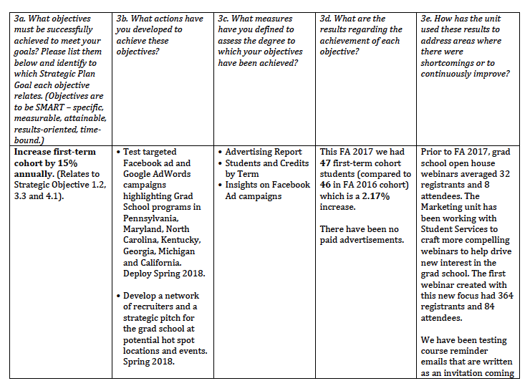
Group Learning: Units
Objectives link to Strategic Plan
Actions are decided by unit
Resources needs are data driven
Reflect on continual improvement

Slide 18
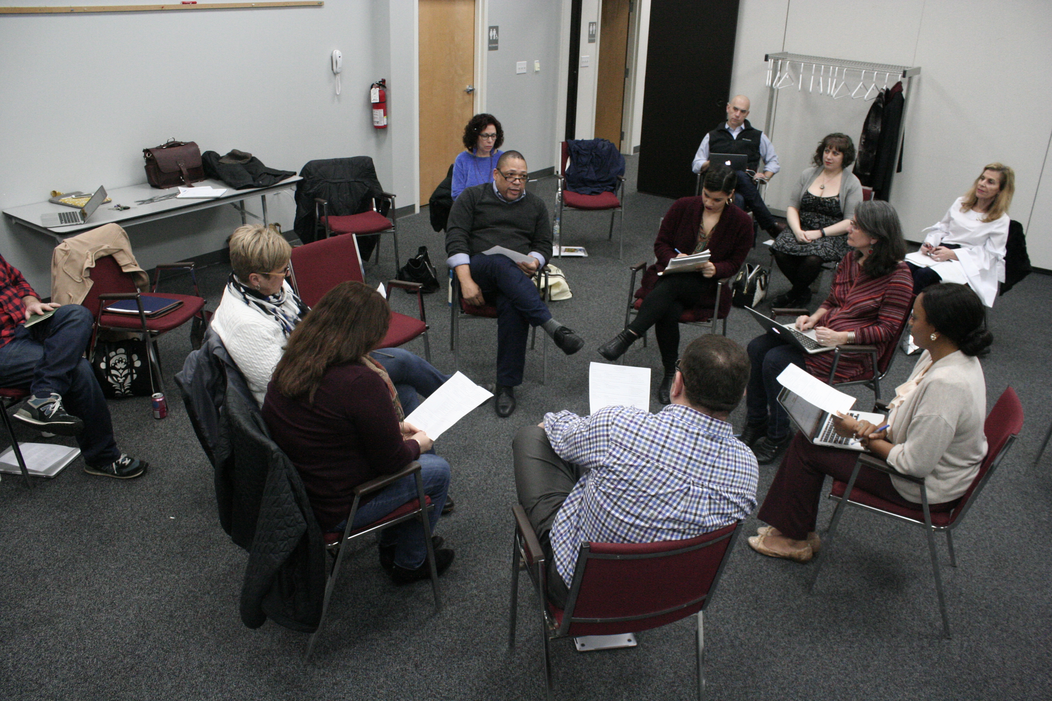
Engagement: Biannual budget Meetings

Slide 19
Engagement>Explanation>Expectation Clarity
Annual Budget
Fishbowl Circle
Governance Structure
Unit Plans & Reports

Slide 20
Leaders Facilitate
Drive Performance & Collaboration
Diversity Feeds Creativity
Create Shared Knowledge
Build Trust & Respect

Slide 21
Thank you
Linda Kligman
267-975-2254 lindakligman@iirp.edu
Resources Cited
Giles, S. (2018). The new science of radical innovation: The six competencies leaders need to win in a complex world. Dallas, TX: BenBella Books.
Heifetz, R. A. (1994). Leadership without easy answers. Cambridge, MA: Belknap Press of Harvard University Press.
Kim, W. C., & Mauborgne, R. (2003). Fair Process: Managing in the Knowledge Economy. Harvard Business Review, 81(1), 127–136.
Kegan, R., & Lahey, L. L.. (2017). An everyone culture: Becoming a deliberately developmental organization. Boston, MA: Harvard Business Review Press.

